Slide 1

Session-1

Slide 2
Content
Introduction
Types of Mobile Development Approach
Pure Native Approach
Xamarin Native Approach
Xamarin Forms Approach
Xamarin Forms Targeted Platforms
PreRequisites
System Requirements
Installation
Mono Framework
Compilation
Project Flow

Slide 3
Introduction
Xamarin is a cross-platform development tool.
Used to build multi-platform and multi-screen applications.
UI can either be defined in code, or in the XAML markup language.
User Interfaces are rendered using the native controls of the target platform.
Two techniques to create User Interfaces in Xamarin.Forms
Create UIs entirely with C# source code
Use Extensible Application Markup Language (XAML), a declarative markup language.

Slide 4
Types of Mobile Development Approach
Pure Native Approach
Xamarin Native Approach
Xamarin Forms Approach

Slide 5



Pure Native
Uses Java or Kotlin
Uses Objective-C or Swift
Uses C#

Slide 6
Pros
Cons
Best end user experience
Highest ceiling for performance
Natural look and feel
Directly access device features and services via API
Easily provide appropriate interfaces depending on device
Utilize Native IDE, Documentation and Development tools
Easier to debug and profile code
Most accurate product for a single market
High development cost
Requires knowledge of each language you target
Separate codebases for each platform
Different IDE's and tools available on each platform
Requires additional knowledge, skills, and work for each additional platform
Need separate Team for each Platform

Slide 7
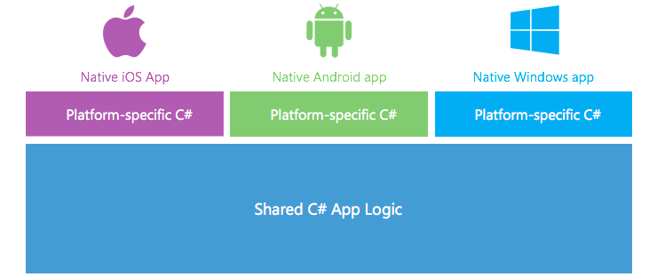
Xamarin Native

Slide 8
Pros
Cons
Create one UI per platform
Easy ability to adjust the platform specific UI features and components
Get the maximum out of your UI
Cross platform development process is slower
Need to learn all native UI frameworks
May result in having duplicate code (same UI in three different platform specific ways)

Slide 9
Xamarin Native best for:
Apps that require specialized interactions
Apps with highly polished design
Apps that use many platform-specific APIs
Apps where custom UI is more important than code sharing

Slide 10
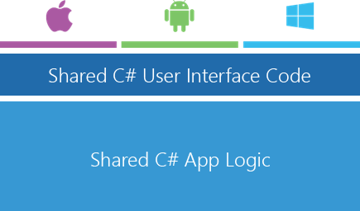
Xamarin Forms

Slide 11
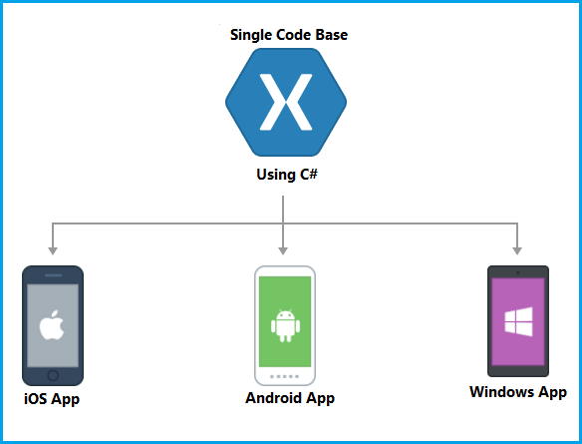

Slide 12
Features of Xamarin Forms
Single Code Base is required to run application on Android, iOS, Windows, and etc.
Single UI and Single Business Logic.
Uses Native Control to display.
No need to learn all the native UI frameworks
Fast cross platform development process
We can also enhance app performance using the Xamarin Insight. The Xamarin Insight helps to monitor and keep a record of crashes and exceptions.
There is no need to create different API for different mobile platforms because the Xamarin allows you to use the same API to build iOS, Android, and Windows applications.
Xamarin allows you to generate productive and high-performing code that can access every native API.
It is very easy to create the device-specific applications over different mobile platforms.

Slide 13
Xamarin Forms best for:
Data entry apps
Prototypes and proofs-of-concept
Apps that require little platform-specific functionality
Apps where code sharing is more important than custom UI

Slide 14
Xamarin Forms Targeted Platforms
iOS 8 or higher
Android 4.0.3 (API 15) or higher
Windows 10 Universal Windows Platform
Windows 8.1 / Windows Phone 8.1 WinRT

Slide 15

Prerequisites

Slide 16
Requirements

Slide 17
Operating System Requirements
Mac
OS X El Capitan (10.11) or newer.
Visual Studio for Mac or Xamarin Studio
iOS 10 SDK and Xcode 8.3(or above).
An Apple ID. It's necessary to have an Apple ID for installing and signing into Xcode.
Windows
Windows 7 or higher.
Visual Studio 2013 Update 2 or newer
A networked Mac is required for iOS development.

Slide 18
Software Requirements
Android
Latest Android SDK Tools
Android API platform installed.
Universal Windows Platform (UWP):
Windows 10
Visual Studio 2015 or newer
Universal Windows Developer Tools
Windows 10 UWP projects are not added when a solution is created on macOS.
Windows 8.1 and Windows Phone 8.1 WinRT:
Windows 8.1
Visual Studio 2013 Update 2 or newer
Windows 8.1 / Windows Phone 8.1
WinRT projects are not added when a solution is created on macOS.

Slide 19
Installation

Slide 20
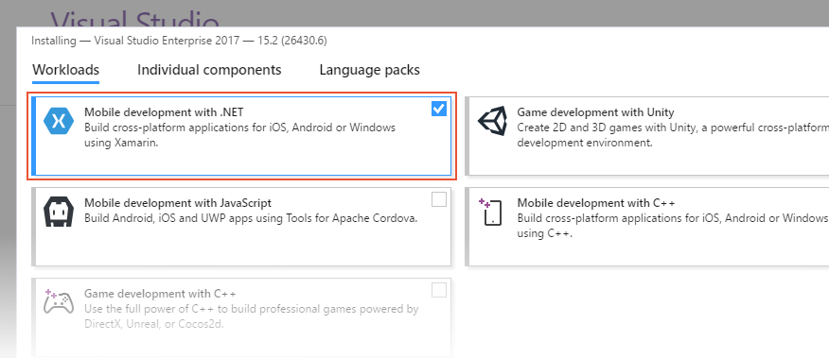
Installing Xamarin in Visual Studio on Windows
Xamarin can be installed as part of a new Visual Studio installation. To achieve this, use the following steps:
Download Visual Studio
Double-click the downloaded package to start installation.
Select the Mobile development with .NET workload from the installation screen:

Slide 21
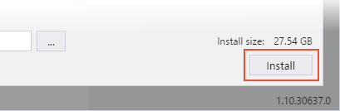
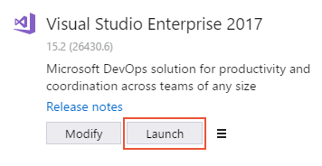
Installing Xamarin in Visual Studio on Windows
4. When you are ready to begin Visual Studio installation, click the Install button in the lower right-hand corner:
5. When Visual Studio installation has completed, click the Launch button to start Visual Studio:

Slide 22
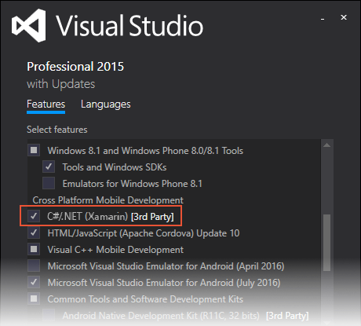
Installing Xamarin in Visual Studio on Windows
To add Xamarin.Android to an existing installation of Visual Studio 2015, use the following steps:
Right-click the Windows Start button and select Programs and Features.
Right-click Microsoft Visual Studio and click Change.
When the Visual Studio Installer dialog appears, click the Modify button.
In the Features tab, scroll down to Cross Platform Mobile Development. Click the checkbox next to C#/.NET (Xamarin):
Click the UPDATE button to add Xamarin to Visual Studio.

Slide 23

Installing Xamarin in Visual Studio on MAC
Download Visual Studio for Mac
Once the installer package is downloaded, click the VisualStudioInstaller.dmg file to mount the installer and then run it by double-clicking the logo, as illustrated by the following image:

Slide 24
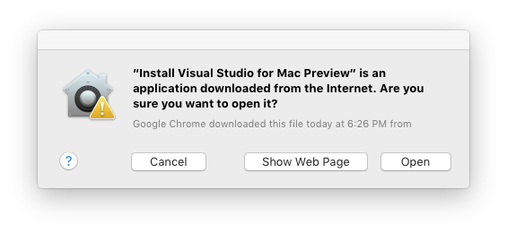
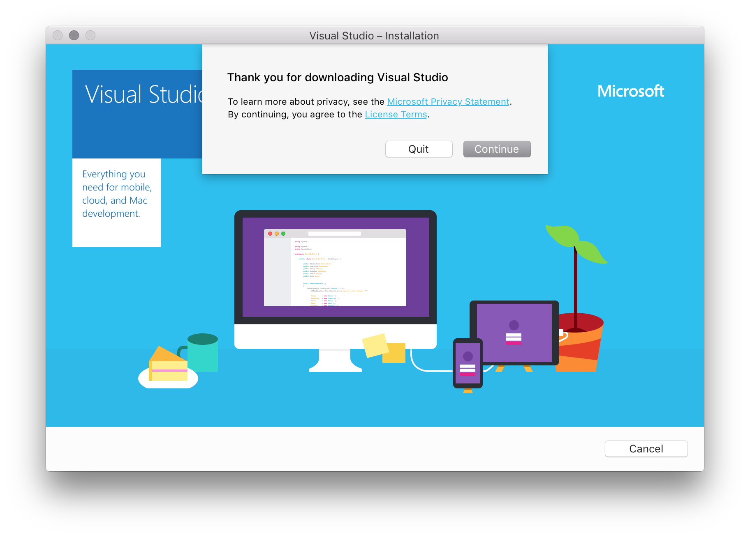
3. You might be prompted with an alert dialog similar to the following image. In this case, click Open:
4. The installer inspects your system to verify which components need to be installed or updated:

Slide 25
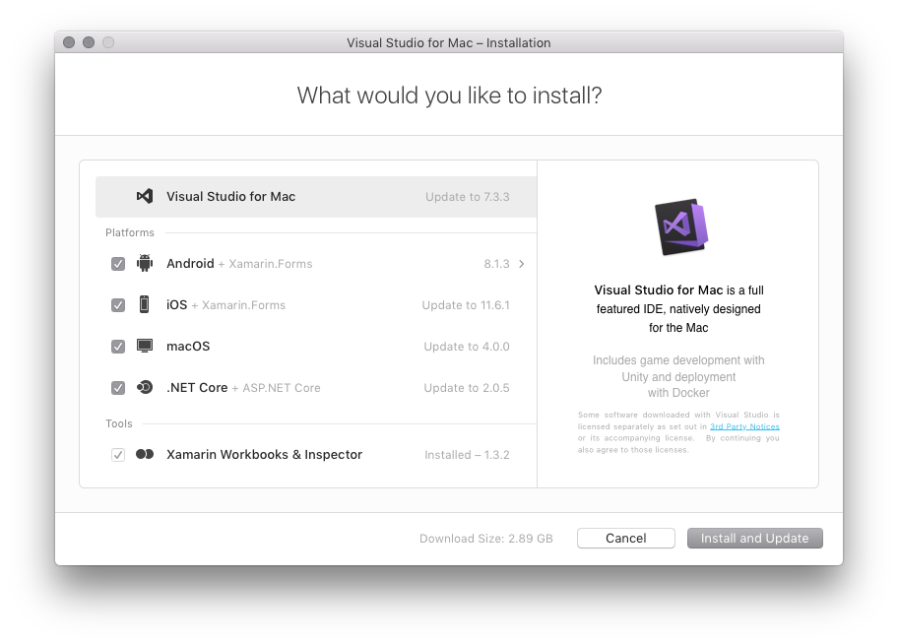
5. The installer presents a list of required components that are missing and that need to be downloaded and installed. Select the products you wish to download here:
Apps using Xamarin:
Xamarin.Forms – Select Android and iOS platforms.
iOS only – Select iOS platform (Note that you will need to install Xcode).
Android only – Select Android platform (Note that you should also select the relevant dependencies).
Mac only – Select macOS platform (Note that you will need to install Xcode).
Fully cross-platform Xamarin apps – Select Android, iOS, and macOS platforms.

Slide 26
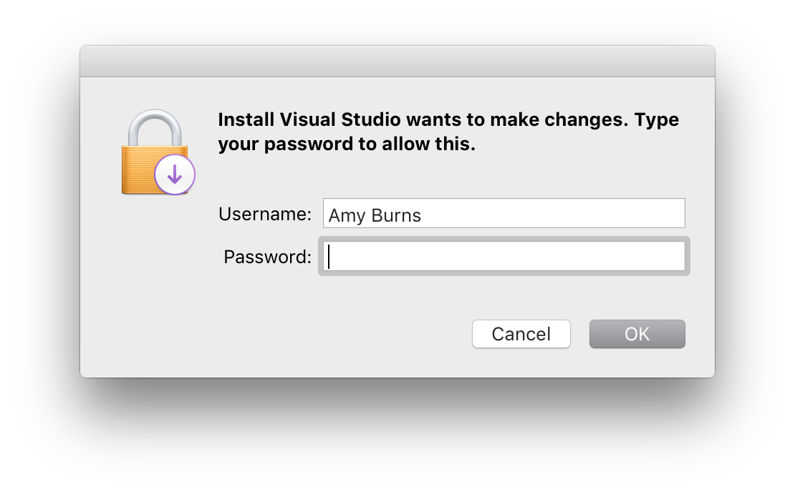
6. select the Install and Update button to start the installation process.
7. You might be prompted to elevate the permissions necessary for individual components that are needed to complete installation. Enter your administrator credentials here to continue the installation process
8. Once the installation is successful, you can start developing apps in Visual Studio by pressing Start:

Slide 27
Mono Framework
Mono is an implementation of the .NET Framework.
The MONO project started in 2001, but the first stable release 1.0, was issued in Q2 2004.
Main aim was to move the .NET Framework from the one vendor solution into a wide and portable standard for a number of platforms and operating systems.
Xamarin has relicensed the Mono runtime under the MIT license and has contributed the code for Mono, as well as the Xamarin SDKs for iOS and Android to the .NET Foundation.

Slide 28

Compilation
C# is compiled to IL and packaged with MonoVM + JIT’ing
The application runs side-by-side with Java/ART (Android runtime) and interacts with the native types via JNI
C# is ahead-of-time (AOT) compiled to ARM assembly language
Apple does not allow runtime code generation on iOS, so some language features are not available
C# is compiled to IL and executed by the built-in runtime, and does not require Xamarin tools.
Universal Windows Platform also has a .NET Native option which behaves similarly to Xamarin.iOS' AOT compilation
Notes:
https://developer.xamarin.com/guides/android/advanced_topics/limitations/
https://developer.xamarin.com/guides/ios/advanced_topics/limitations/

Slide 29
Project Flow

